Slide 1
7 Algorithm design and problem-solving
Identifying errors and suggesting fixes

Slide 2


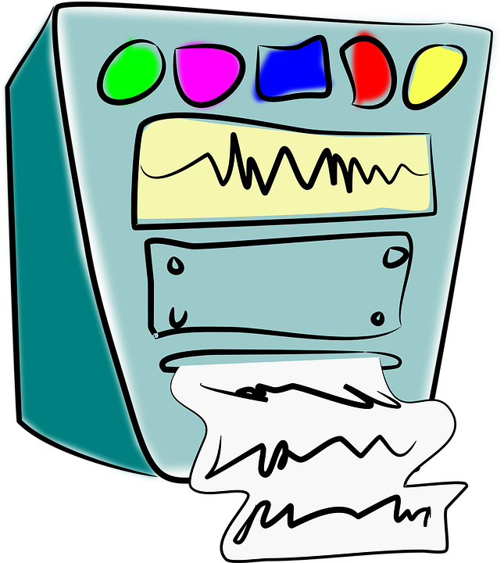

Types of errors
Syntax errors
Logic errors
Syntax errors are errors that break the grammatical rules of the programming language and prevent it from being run or translated.
Logic errors are errors that produce unexpected output but won’t stop the program running.

Slide 3
Types of errors
See if you can spot the errors in this program and suggest how they can be fixed.
//program to work out if you are old enough to vote
CONSTANT VotingAge ß 18
OUTPUT "How hold are you?"
INPUT YourAge
IF (YourAge <= VotingAge)
OUTPUT "You are old enough to vote"
ELSE
OUTPUT "You are not old enough to vote
ENDIF

Slide 4
Syntax errors
Here we have missed out an essential key word – this is a syntax error, which will prevent the program from running.
//program to work out if you are old enough to vote
CONSTANT VotingAge ß 18
OUTPUT "How hold are you?"
INPUT YourAge
IF (YourAge <= VotingAge)
OUTPUT "You are old enough to vote"
ELSE
OUTPUT "You are not old enough to vote
ENDIF
We have missed the key word THEN, which goes with the IF statement

Slide 5
Syntax errors
Here we have missed out an essential key word – this is a syntax error, which will prevent the program from running.
//program to work out if you are old enough to vote
CONSTANT VotingAge ß 18
OUTPUT "How hold are you?"
INPUT YourAge
IF (YourAge <= VotingAge)
THEN
OUTPUT "You are old enough to vote"
ELSE
OUTPUT "You are not old enough to vote
ENDIF

Slide 6
Syntax errors
There is still one syntax error remaining – can you spot it?
//program to work out if you are old enough to vote
CONSTANT VotingAge ß 18
OUTPUT "How hold are you?"
INPUT YourAge
IF (YourAge <= VotingAge)
THEN
OUTPUT "You are old enough to vote"
ELSE
OUTPUT "You are not old enough to vote
ENDIF

Slide 7
Syntax errors
We are missing the double quotes on the end of the output line – this is a syntax error, which will prevent the program from running.
//program to work out if you are old enough to vote
CONSTANT VotingAge ß 18
OUTPUT "How hold are you?"
INPUT YourAge
IF (YourAge <= VotingAge)
THEN
OUTPUT "You are old enough to vote"
ELSE
OUTPUT "You are not old enough to vote
ENDIF
Missing double quotes

Slide 8
Syntax errors
We are missing the double quotes on the end of the output line – this is a syntax error, which will prevent the program from running.
//program to work out if you are old enough to vote
CONSTANT VotingAge ß 18
OUTPUT "How hold are you?"
INPUT YourAge
IF (YourAge <= VotingAge)
THEN
OUTPUT "You are old enough to vote"
ELSE
OUTPUT "You are not old enough to vote"
ENDIF

Slide 9
Syntax errors
All the syntax errors have now be fixed, so the program will run. However, it won’t behave as expected because a logical error remains – can you spot it?
//program to work out if you are old enough to vote
CONSTANT VotingAge ß 18
OUTPUT "How hold are you?"
INPUT YourAge
IF (YourAge <= VotingAge)
THEN
OUTPUT "You are old enough to vote"
ELSE
OUTPUT "You are not old enough to vote"
ENDIF

Slide 10
Logical errors
We used the wrong comparison operator – this is a logical error. The program would run, but it would not behave as expected, allowing only people under the age of 18 to vote.
//program to work out if you are old enough to vote
CONSTANT VotingAge ß 18
OUTPUT "How hold are you?"
INPUT YourAge
IF (YourAge <= VotingAge)
THEN
OUTPUT "You are old enough to vote"
ELSE
OUTPUT "You are not old enough to vote"
ENDIF
<= voting_age will only permit users aged 18 or under to vote

Slide 11
Logical errors
We used the wrong comparison operator – this is a logical error. The program would run, but it would not behave as expected, allowing only people under the age of 18 to vote.
//program to work out if you are old enough to vote
CONSTANT VotingAge ß 18
OUTPUT "How hold are you?"
INPUT YourAge
IF (YourAge >= VotingAge)
THEN
OUTPUT "You are old enough to vote"
ELSE
OUTPUT "You are not old enough to vote"
ENDIF

Slide 12


